Slide 1
Ghana Communication Technology University (GCTU)
WEEK ONE LECTURE NOTES
Course Title: Microprocessors and Microcontrollers
Lecturer: Apostle Isaac Frank Agidi
Co-Lecturer: Ing. Kenneth Prince Amoah
Week: 1 (10th – 16th November 2025)

Slide 2
Topic: Introduction and Fundamentals of Microprocessors and Microcontrollers
1.0 Learning Objectives
By the end of this lecture, students should be able to:
Explain the evolution of computers and processors.
Distinguish between microprocessors and microcontrollers.
Identify the key components and functions of a microprocessor-based system.
Understand the architecture and features of Intel 8085 microprocessor.
Appreciate the importance of microcontrollers in embedded systems.

Slide 3
2.0 Introduction
Microprocessors and microcontrollers form the foundation of modern computing and embedded systems. They are the "brains" of almost every electronic device—from computers and smartphones to washing machines and cars.
Understanding their architecture, programming, and operation is crucial for anyone studying computer science, electrical engineering, or IT.

Slide 4
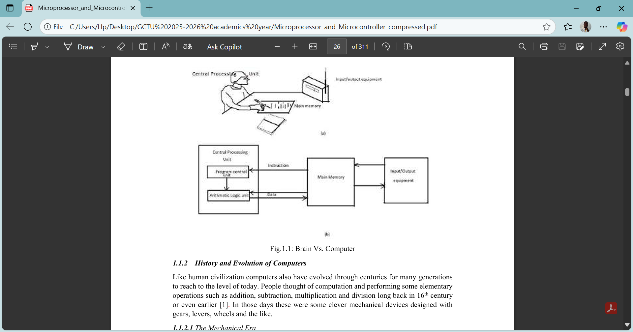

Slide 5
3.0 Evolution of Computers and Processors
3.1 The Mechanical Era
Early computing devices were mechanical (e.g., Pascal’s calculator, Leibniz’s multiplier).
These could perform basic operations (addition, subtraction) but were slow and bulky.

Slide 6
3.2 The Electronic Age
Transition from mechanical to electronic devices began with vacuum tubes.
Major developments:
  1943–46: ENIAC – first electronic computer.
  1951: UNIVAC – first commercial computer.
  1964: IBM System/360 – standard computer series.

Slide 7
The first generation (1940-1950)
First by John V. Atanasoff (1903-95), at Iowa State University, in late 1930s
● The Electronic Numeric Integrator and Calculator (ENIAC) by Mauchly and Eckert in the University of Pennsylvania, 1943-46
● The first commercial product by Eckert-Mauchly Corp was UNIAC (Universal Automatic Computer) in 1951.
● IAS Computer, by von Neumann, at the Institute for Advanced Studies in Princeton began to work on the design of a new stored program electronic computer, 1947

Slide 8
The second generation (1954-64)
Key Features
● The vacuum tubes and electronics valves were soon replaced by bipolar junction transistors, in 1947
● the second-generation computers based on transistors soon replaced the first generation of vacuum tube-based machines
● drastic reduction in size and cost and power.
● Computational speed also enhanced to a great extent.
● ferrite cores became the dominant technology for main memories until it is superseded by the all-transistor memories in 1970s.
● Magnetic disks became the principal technologies for secondary memories since then.

Slide 9
● With the introduction of index registers, it is possible to have indexed instructions, which increments or decrements the designated index I.
● Another innovation in second generation was the introduction of program-control instructions: call and return which allow the linking of programs.
● It allowed to perform operations on floating point numbers,
● With the introduction of compilers in has become possible to write instructions in high level language.
● For system management, batch processing came into existence. Batch processing makes use of supervisory program known as batch monitor which is a rudimentary version of operating system, which is a system program designed to manage computer’s resources efficiently.

Slide 10
The third generation (1965-75)
● introduction of silicon based integrated circuits (ICs) in the design of computer hardware, in 1961
● This replaced all the second-generation computers designed with discrete transistors,
● reduced size, cost and enhanced the speed.
● The most significant event during this period was the recognition of the need to standardize the computers,

Slide 11
● more and more software were developed and used more efficiently. ● IBM developed the most influential third-generation computer, the System/360 which was announced in 1964 and came in the year 1965.
● Since then System/360 became the de-facto standard and all the models in the series are software compatible with each other (share common instruction set).
● Introduction of status register (SR) to save the program status word, for any exceptional conditions, errors, divide by zero or any urgent service requests such as interrupts.

Slide 12
3.3 The VLSI Era
Development of Integrated Circuits (ICs) in 1959 revolutionized computing.
Allowed thousands, then millions, of transistors to fit on a single chip.
Led to microprocessors, starting with Intel 4004 (1971) and 8085 (1976).

Slide 13
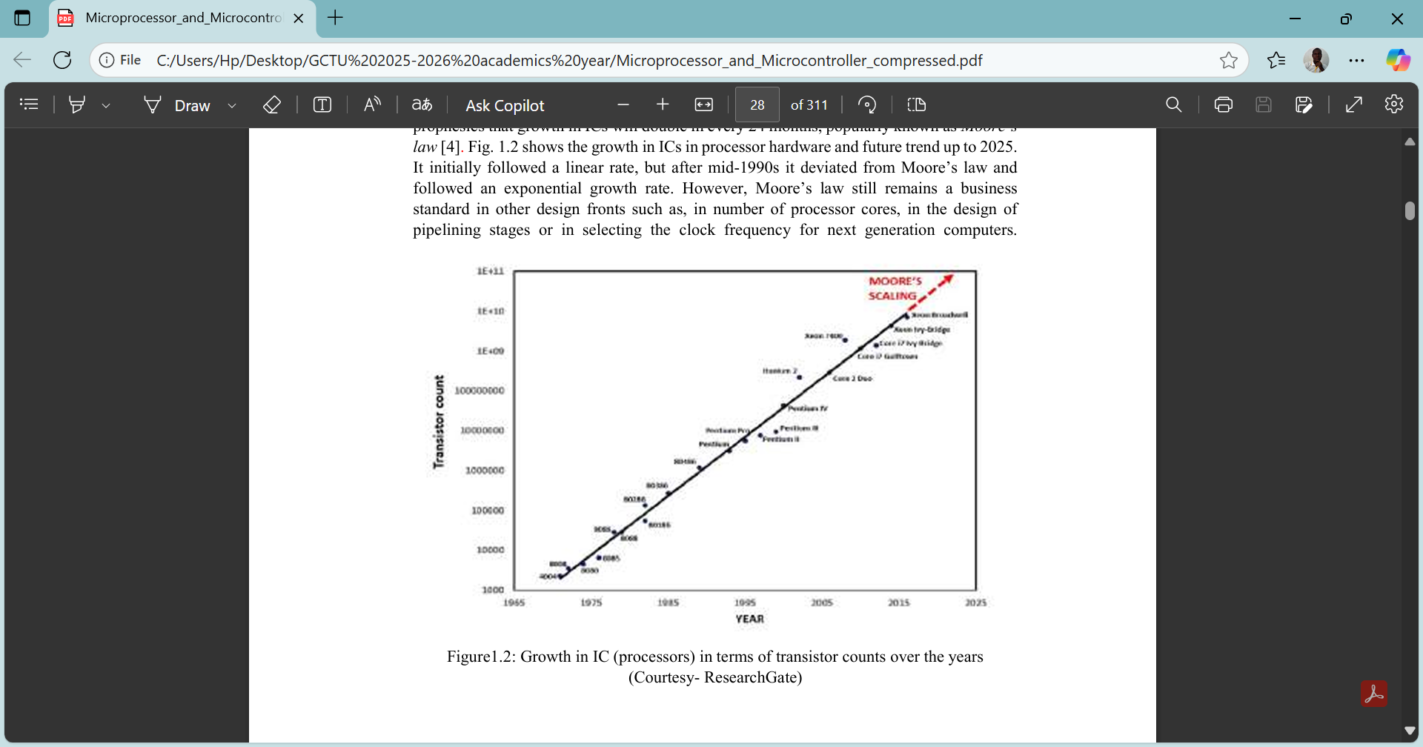

Slide 14
4.0 Microprocessor Fundamentals
Definition:
A microprocessor is an integrated circuit that performs all the functions of a CPU on a single chip. It processes binary data, executes instructions, and controls system operations.
Components:
ALU (Arithmetic Logic Unit) – Performs arithmetic and logical operations.
Registers – Small, high-speed storage for temporary data.
Control Unit – Directs operations within the CPU.

Slide 15
Buses –
  Address Bus: Identifies memory locations.
  Data Bus: Transfers data.
  Control Bus: Carries control signals.

Slide 16
Functions:
Fetch → Decode → Execute cycle.
Communication with input/output devices.
Handling interrupts and timing operations.

Slide 17
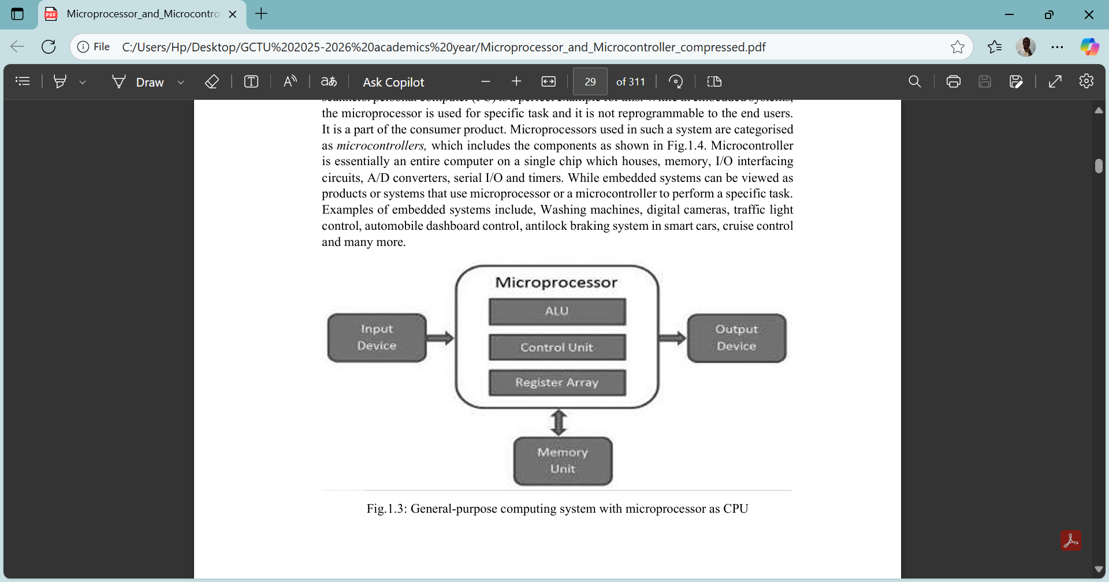

Slide 18
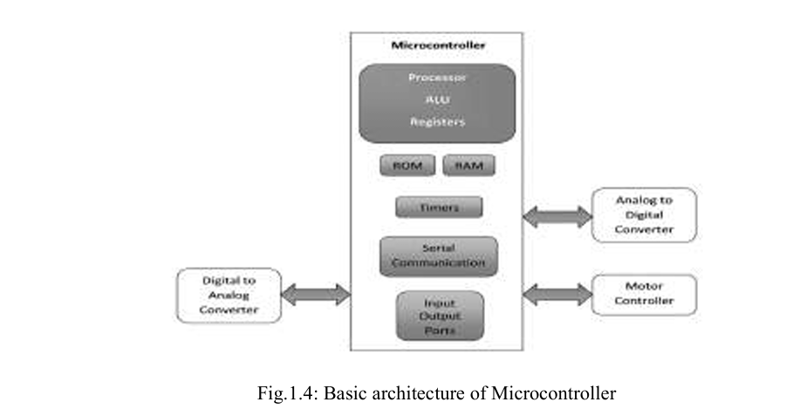

Slide 19
5.0 The 8085 Microprocessor
Key Features:
8-bit processor (data bus width = 8 bits).
16-bit address bus (can access 64 KB memory).
5 addressing modes.
Operates at 3 MHz with +5V power.
74 instructions total.

Slide 20
Architecture Overview:
Registers: A, B, C, D, E, H, L.
Accumulator (A): Central register used in arithmetic/logic operations.
Flag Register: Indicates conditions (zero, carry, sign, parity, auxiliary carry).
Program Counter (PC): Points to next instruction.
Stack Pointer (SP): Tracks memory for temporary data

Slide 21
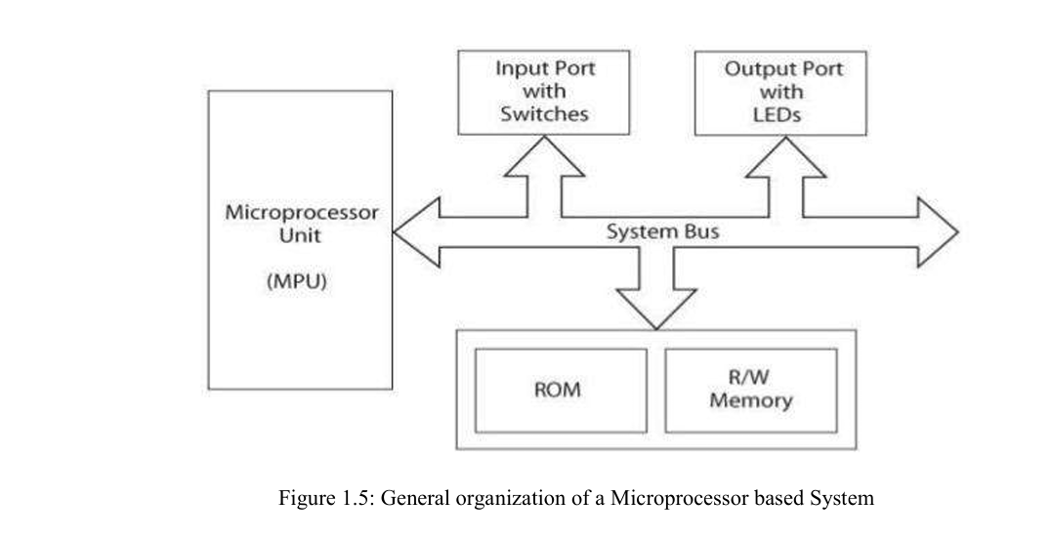

Slide 22
6.0 Microcontrollers
A microcontroller is a compact integrated circuit that contains a processor (CPU), memory (RAM/ROM), and input/output peripherals on one chip.

Slide 23
Difference Between Microprocessor and Microcontroller:
Feature | Microprocessor | Microcontroller
Function | General-purpose computing | Specific embedded tasks
Components | CPU only | CPU + Memory + I/O
Cost | Higher | Lower
Power consumption | Higher | Lower
Applications | PCs, servers | Appliances, automation

Slide 24
Examples:
8085, 8086 → Microprocessors
8051, PIC, ARM → Microcontrollers

Slide 25
7.0 Embedded Systems
Embedded systems integrate microcontrollers to perform dedicated functions.
Examples:
  Traffic lights
  Washing machines
  Automotive control systems
  Smart thermostats

Slide 26
8.0 Summary
The evolution of processors has moved from mechanical calculators to highly integrated chips.
8085 serves as a foundation for understanding modern CPU design.
Microcontrollers combine multiple components on a single chip for specific applications.
Embedded systems use these controllers for automation and control

Slide 27
9.0 Review Questions
Differentiate between a microprocessor and a microcontroller.
State five features of the Intel 8085 microprocessor.
Describe the three main buses in a microprocessor system.
Explain how the evolution of computers led to the invention of the microprocessor.
Give three examples of embedded systems in everyday life

Slide 28
THE END OF LECTURE ONE

